Slide 1
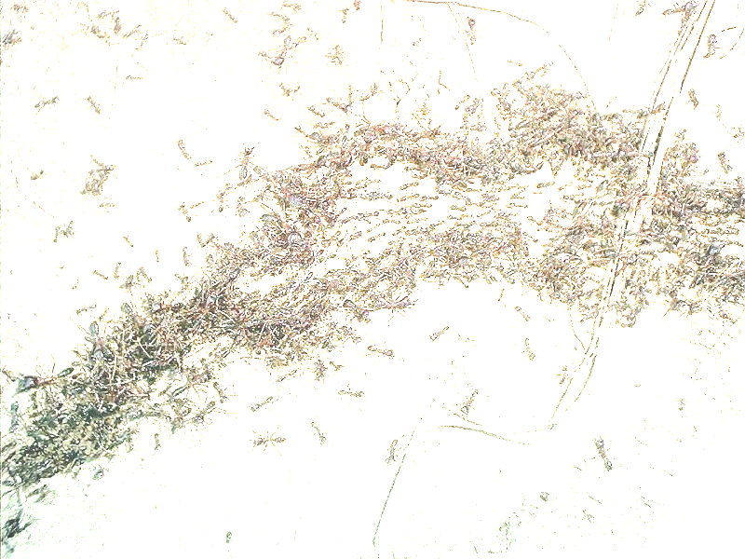
Swarm-Based Traffic Simulation
Darya Popiv, TUM – JASS 2006

Slide 2
Content
Introduction
Swarm Intelligence
Pheromones in Traffic Simulation
Vehicular Model and Environment
Software: SuRJE

Slide 3
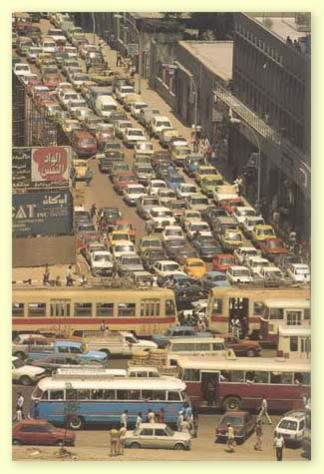
Introduction: Why to do Traffic Simulation?
Traffic congestions
  Economical Implications
  Social Implications
Increasing amount of accidents
Perfect tool for road planning

Slide 4
Introduction: How to do Traffic Simulation?
Macro model
  Treats traffic flow as a fluid not taking into account individual agents
  Navier-Stokes equation
Micro model
  Treats traffic flow as the result of the interaction between individual agents
  Well-known approach: Nagel-Schreckenberg cellular automata

Slide 5
Introduction: How to do Traffic Simulation?
Micro model in more detail: drivers act as individual agents, influenced by
  traffic rules
  signs
  traffic lights
  others’ drivers driving

Slide 6
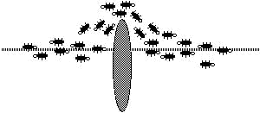
Swarm-based Traffic Simulation
Micro model simulation
Interaction between agents is based on swarm intelligence

Slide 7
Content
Introduction
Swarm Intelligence
Pheromones in Traffic Simulation
Vehicular Model and Environment
Software: SuRJE

Slide 8
Swarm Intelligence
“Swarm Intelligence is a property of systems of non-intelligent robots exhibiting collectively intelligent behavior.” [G. Beni, "Swarm Intelligence in Cellular Robotic Systems", Proc. NATO Adv. Workshop on Robotics and Biological Systems, 1989 ]
Characteristics of a swarm:
  distributed, no central control or data source
  perception of environment, i.e. sensing
  ability to change environment
  examples: ant colonies, termites, bees

Slide 9
Swarm Intelligence: Stigmergy
Stigmergy is a method of communication in emergent systems in which the individual parts of the system communicate with one another by modifying their local environment
Ants communicate to one another by laying down pheromones along their trails

Slide 10
Swarm Intelligence in Traffic Simulation
Cars, like ants, leave pheromones
  Pheromones are expressed in terms of visual and perceptional signals
    Braking lights
    Turning lights
    Changes in speed
Cars “sniff” pheromones dropped by other cars and adjust their speed and direction accordingly

Slide 11
Content
Introduction
Swarm Intelligence
Pheromones in Traffic Simulation
Vehicular Model and Environment
Software: SuRJE

Slide 12
Pheromones in Traffic Simulation: Rules
Pheromone rules on numerical level
  Pheromones fade over time
  Faster cars leave longer tails of pheromones
  Stronger pheromones are dropped when:
    Car changes lanes
    Car brakes
    Car stops

Slide 13
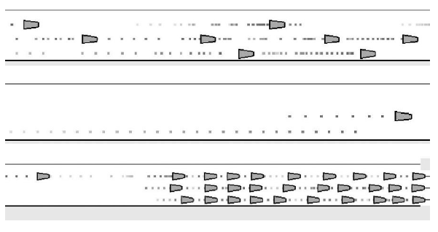
Pheromones in Traffic Simulation:
Illustration
Driving, changing lanes, stopping

Slide 14
Pheromones in Traffic Simulation:
Algorithm
“Sniffs” pheromone in front, if not yet arrived to destination point
Decelerate, if tailing distance to the next car is less than strength of pheromone suggests
Accelerate, if there is no pheromone or tailing distance is greater than suggested by pheromone strength

Slide 15
Pheromones in Traffic Simulation:
Algorithm cont.
Stop, if needed
Make decision about upcoming turn (change lanes?)
Drop single pheromone, or a trail of pheromones
Update car position

Slide 16
Content
Introduction
Swarm Intelligence
Pheromones in Traffic Simulation
Vehicular Model and Environment
Software: SuRJE

Slide 17
Vehicular Model and Environment in Traffic Simulation
Besides interaction among agents, there are external factors that also influence how traffic behaves
  Shape of the road
  Traffic signs
  Driving rules
Relationship between vehicle agents and environment defines
  Where vehicles can go
  Speed limit
  How to act at intersections

Slide 18
Vehicular Environment
Road map is represented by connected graph
Each agent in the system has its route, defined by road map and rules
Agent only need to know agents in neighboring lanes and through intersections

Slide 19
Vehicle Movement
Route planning
  Choose closest direction to the direction straight to destination point, i.e. with the help of Dijkstra’s shortest path algorithm
Route re-planning
  Occurs if agent was unable to get into an appropriate lane due to congestions
  Starting point is updated and the new route is calculated
Route execution
  Lane changing is triggered by upcoming turn

Slide 20
Content
Introduction
Swarm Intelligence
Pheromones in Traffic Simulation
Vehicular Model and Environment
Software: SuRJE

Slide 21
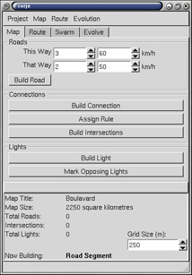
Software: SuRJE (Swarms under R&J using Evolution)
Developed by the research group at University of Calgary, Ricardo Hoar and Joanne Penner
Map-building mode
  Multi-lane roads, connections, lights, signs, speed limits
  Set points, interpolate: straight/curved roads

Slide 22
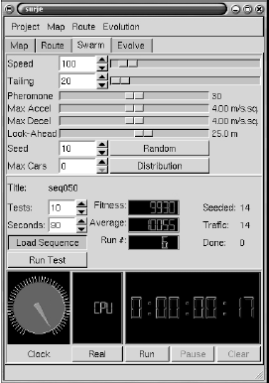
SuRJE: Parameters
Begin/end journey
Rate, at which cars are seeded into the system
Probability for the agent to reach one or another ending point of the journey

Slide 23
SuRJE: Parameters
Strength of pheromone
Mean tailing distance and deviation
Mean speed limit and deviation
Mean stopping distance
Physical maximum acceleration/decelaration

Slide 24
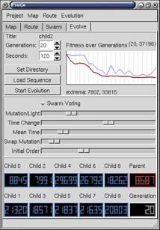
Software: SuRJE
Run mode
  Run swarm of cars on the road

Slide 25


SuRJE: Goal of Simulation
Minimize average waiting time for all cars
  total driving d_{i}^{tot}
  waiting times w_{i}^{tot}
  fitness measure for each car σ_{i}
  overall traffic congestion

Slide 26
SuRJE: Means to reach Goal
Minimize overall traffic congestion by adjusting time sequences of the traffic lights
  Extend/decrease green time
  Swap two timing sequences
  Reassign the starting sequence
  Probabilities for mutation operations are set by user
Swarm voting
  Car casts vote whenever stopped
  Lights with most votes will with higher probability
    Increase their green period
    Reduce green period for one of their opposing lights

Slide 27
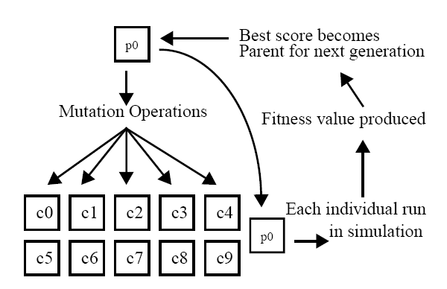
Software: SuRJE
The process of evolution on traffic light sequences

Slide 28
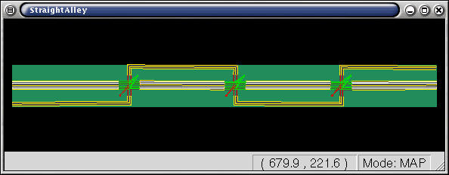
SuRJE: Straight Alley Testbed

Slide 29
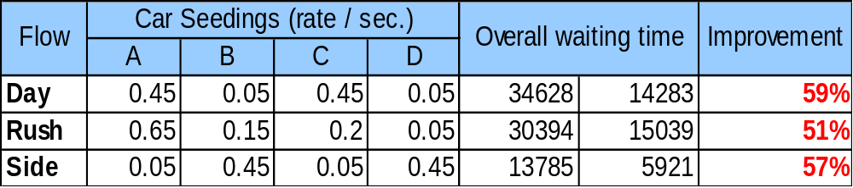
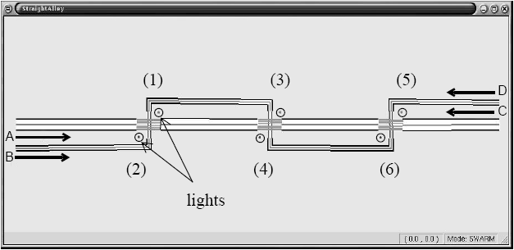
SuRJE: Straight Alley Testbed

Slide 30
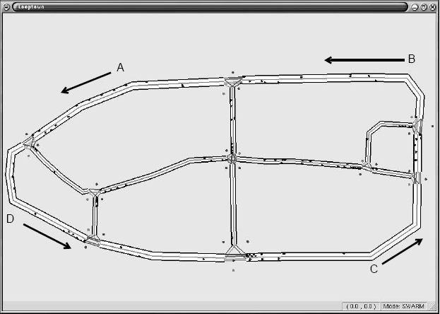
SuRJE: Looptown

Slide 31
SuRJE: Looptown
28 lights, 9 intersections
300 cars are seeded with following rates per second:
  A 0.23
  B 0.31
  C 0.23
  D 0.23
Improvement: 26% decrease of waiting time

Slide 32
Conclusion
New approach on micro traffic simulation is introduced
Biological behavior of colonies, such as ants, can be applied to social interactions, i.e. traffic flow
Algorithms should be chosen
  Route planning
  Adaptive Behavior
  Probability of collisions – dynamic emergence of obstacles

